Slide 1
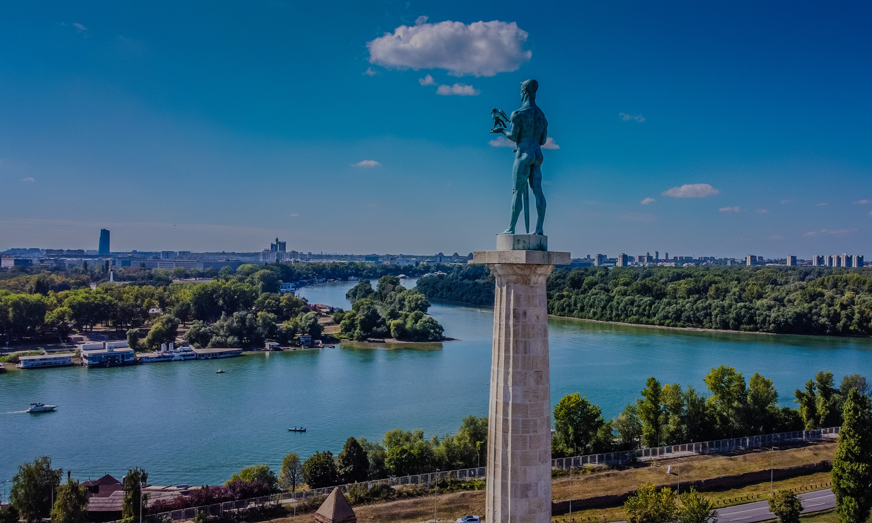



INVESTOMETRIX’S LEVEL I PREP COURSE FOR THE ${\text{CFA}}^{\text{®}}$ PROGRAM – 2026/27

Slide 2

WHAT IS CFA®?
The Chartered Financial Analyst Program® is a professional program that provides a strong foundation of the skills and knowledge needed to succeed in today’s competitive world of investing and finance.
It combines a broad-based curriculum of investment principles with professional conduct requirements. It is administered by the CFA Institute, the global not-for-profit organization of investment professionals.

Slide 3

GLOBAL RECOGNITION
With a six-decade history of maintaining a rigorous focus on globally relevant investment knowledge, it is recognized by the global investment community as the highest educational and professional excellence standard.
Join more than 200,000 finance professionals who have been recognized globally for their commitment to ethics and professionalism.

Slide 4

CAREER ADVANTAGE
Employers recognize the CFA® charter as the definitive standard of competence, integrity, and dedication of investment professionals. The CFA® Program stands out at every stage of your career and equips you with the practical and fundamental knowledge you need for the investment profession.
There is no better way to demonstrate your commitment and your ability to perform at a high level in the investment profession than by enrolling in and completing the CFA® Program.
The CFA® Program curriculum focuses on the practical knowledge and current skills necessary in the global investment management profession.

Slide 5

HOW TO EARN THE CHARTER IN CFA® PROGRAM?
Be passionate and determined in acquiring new financial knowledge.
Demonstrate consistency and discipline in your study path.
Study for and pass three levels (I, II & III) of exams and meet other requirements, such as 4,000 hours of experience completed in a minimum of 3 years.
Each level requires at least 300 study hours within 4-6 months time span (approximately 3,000 pages of curriculum per level).

Slide 6
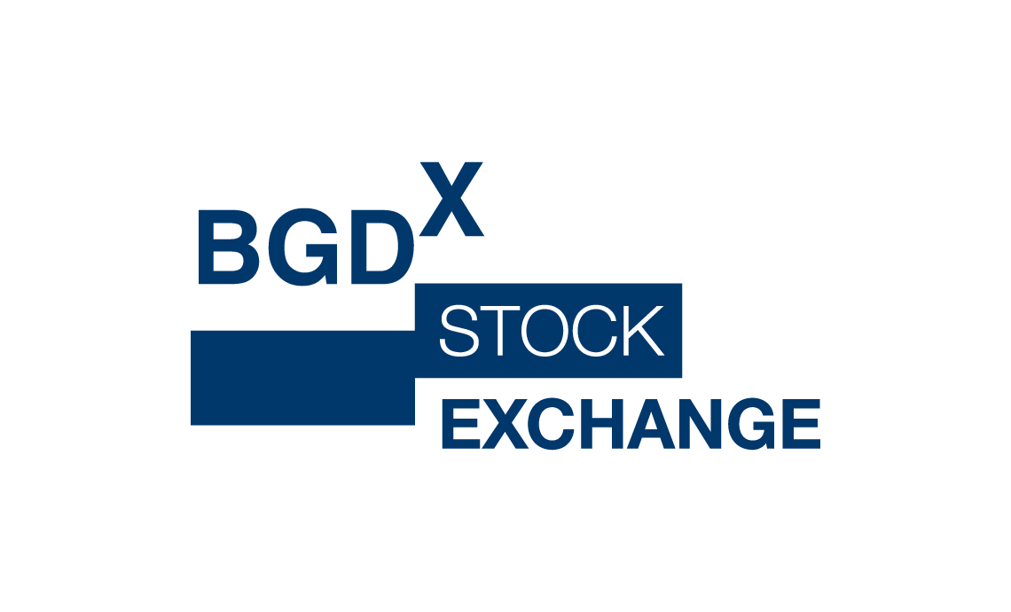



WHY US?
INVESTOMETRIX IS RECOGNIZED BY THE CFA INSTITUTE AS THE APPROVED CFA PREP PROVIDER THAT IS LISTED ON THE GLOBAL CFA INSTITUTE WEBSITE, WHICH MAKES US UNIQUE IN THE REGION.
We demonstrate a strong commitment to knowledge sharing and delivery as per the latest CFA curriculum and learning outcomes, in line with the signed CFA INSTITUTE PREP PROVIDER PROGRAM AGREEMENT.
Our team is made up of experienced lecturers with a proven track record in the professional education field, including the CFA preparation courses.
All lecturers are CFA Charterholders with long-standing academic and industry expertise.

Slide 7
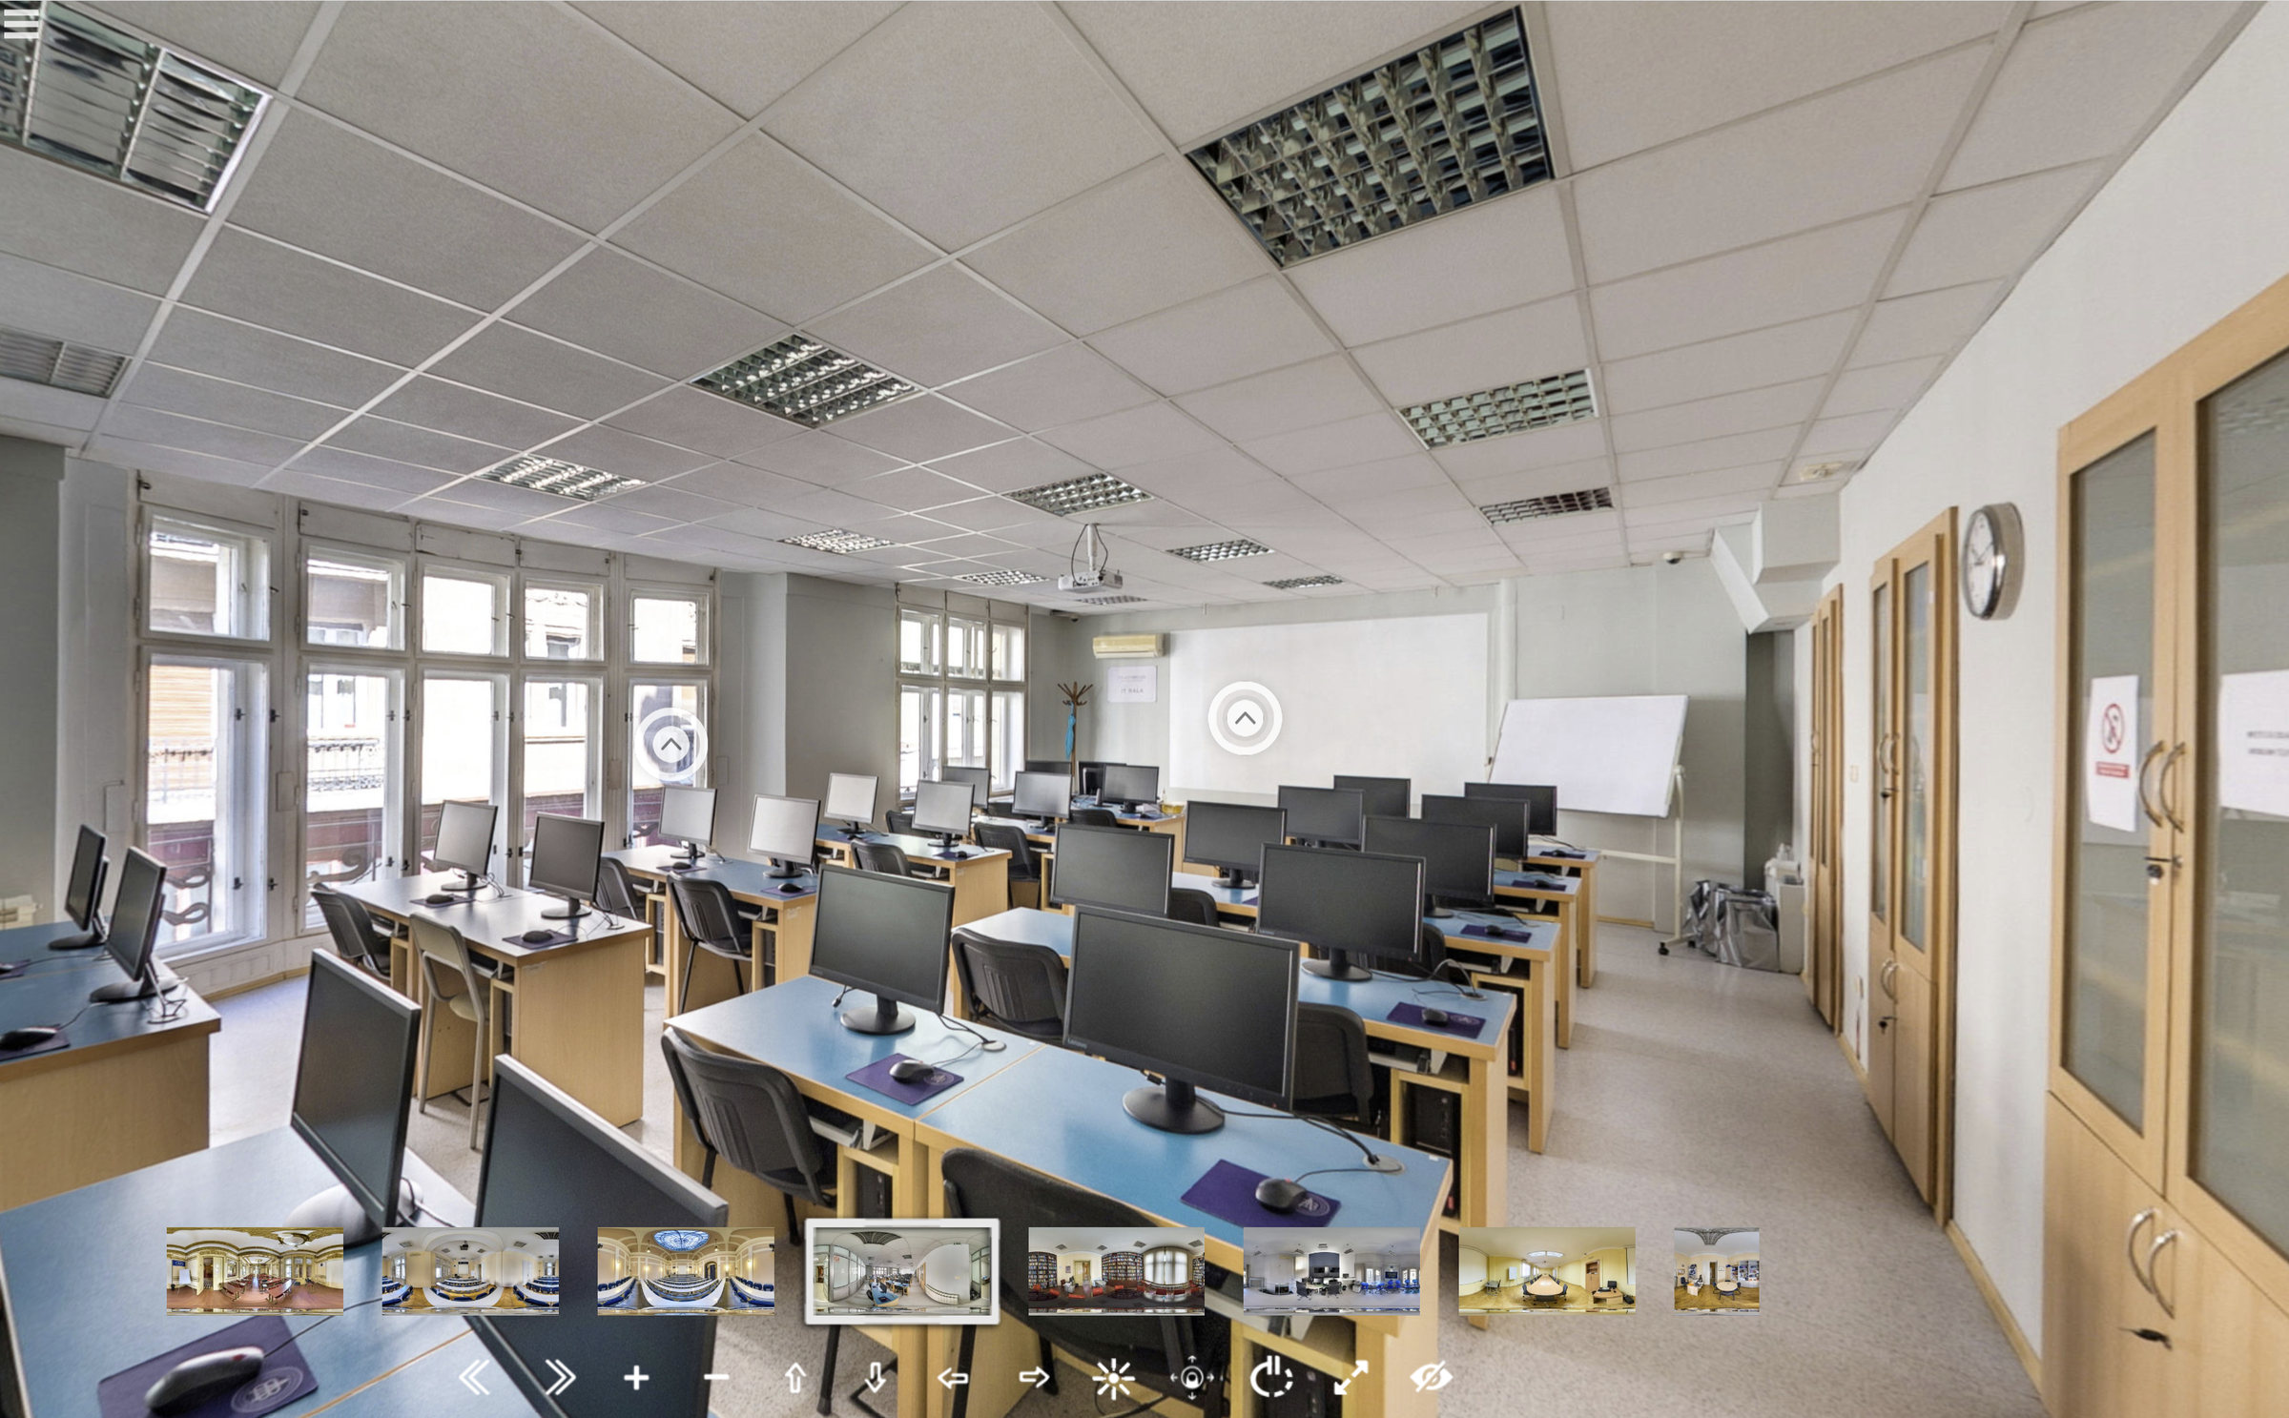

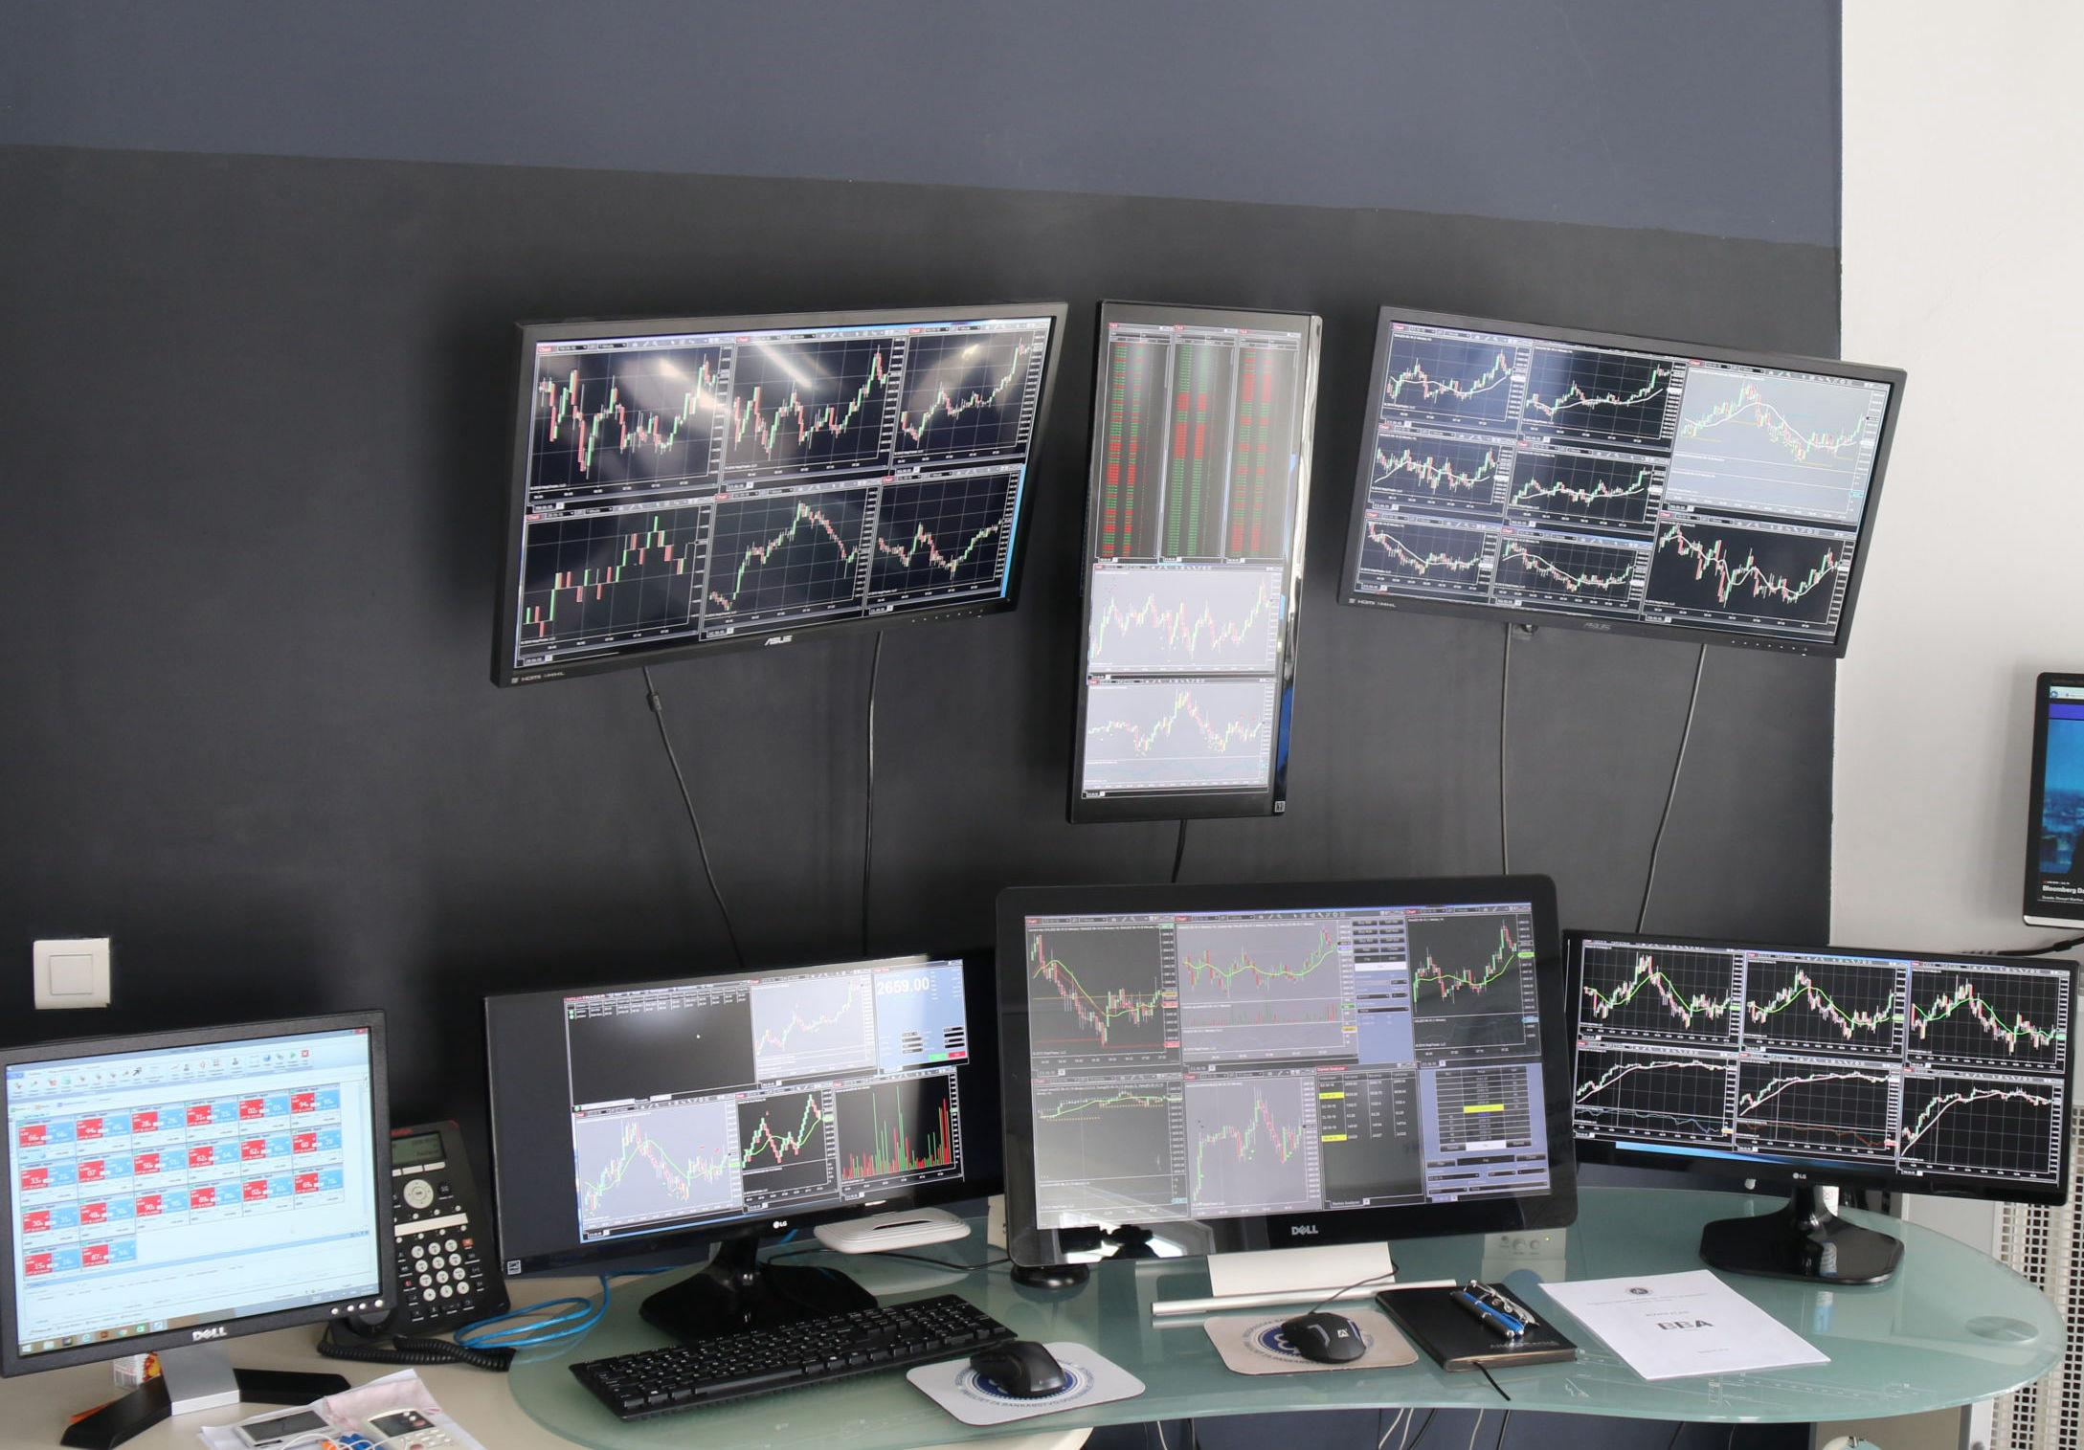
UNIQUE AND COMPREHENSIVE PACKAGE OFFER
Effective coverage of learning outcomes for the Level I curriculum.
Complimentary Investometrix's CFA® Ethical and Professional Standards Prep Course (videos, study notes, and practice questions – included in the price).
Real exam simulation in IT classroom.
Visit to Eclectica Asset Management Company;
Finance Lab experience.
Career tips and advisory for future CFA® aspirants;
Prospects for paid internship in asset management industry.

Slide 8
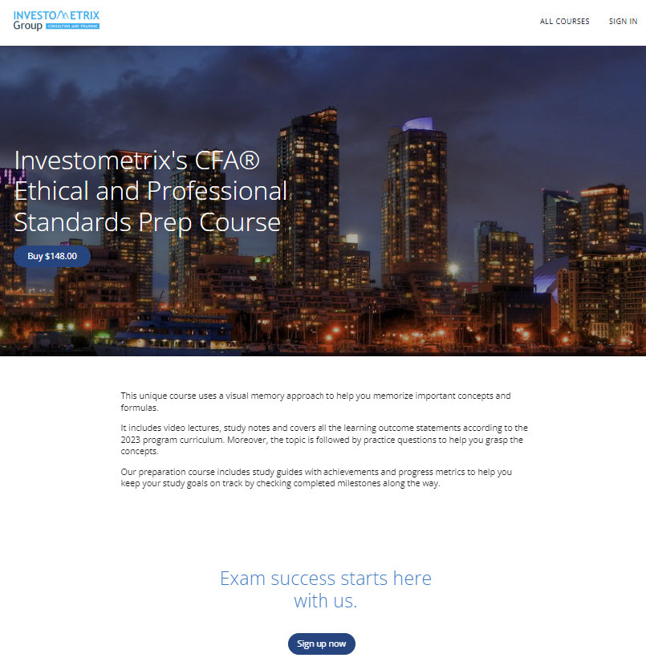
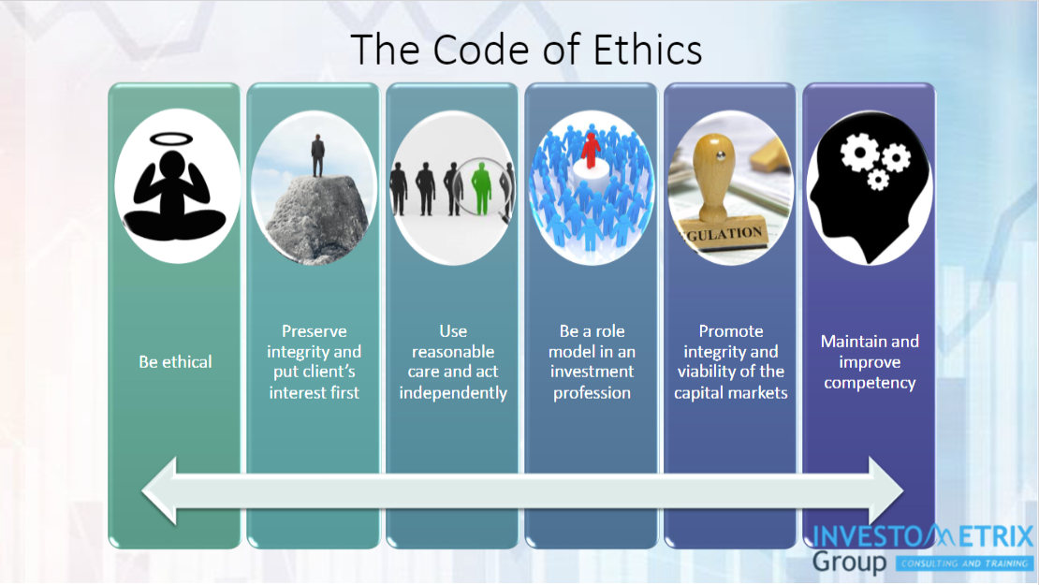
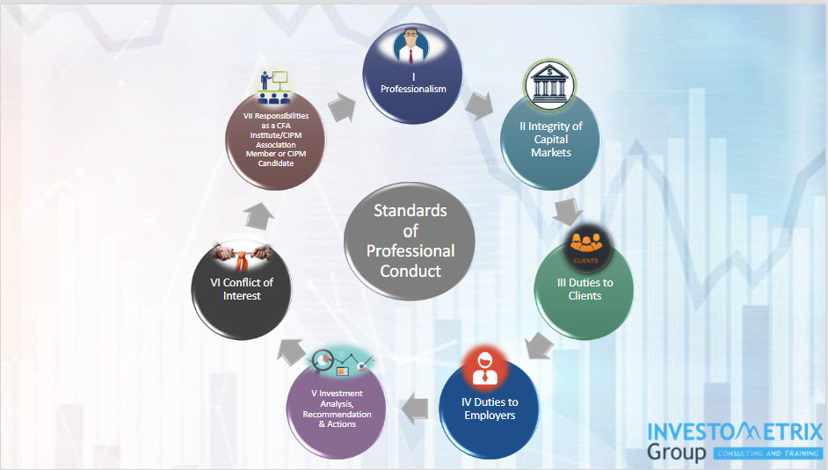
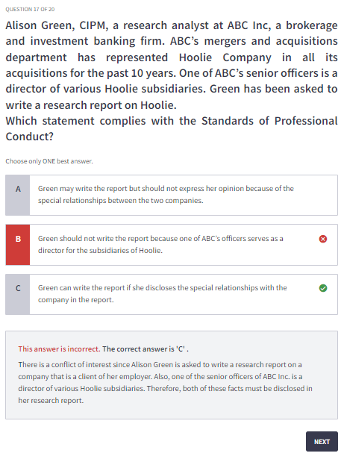
Free Bonus Material

Slide 9
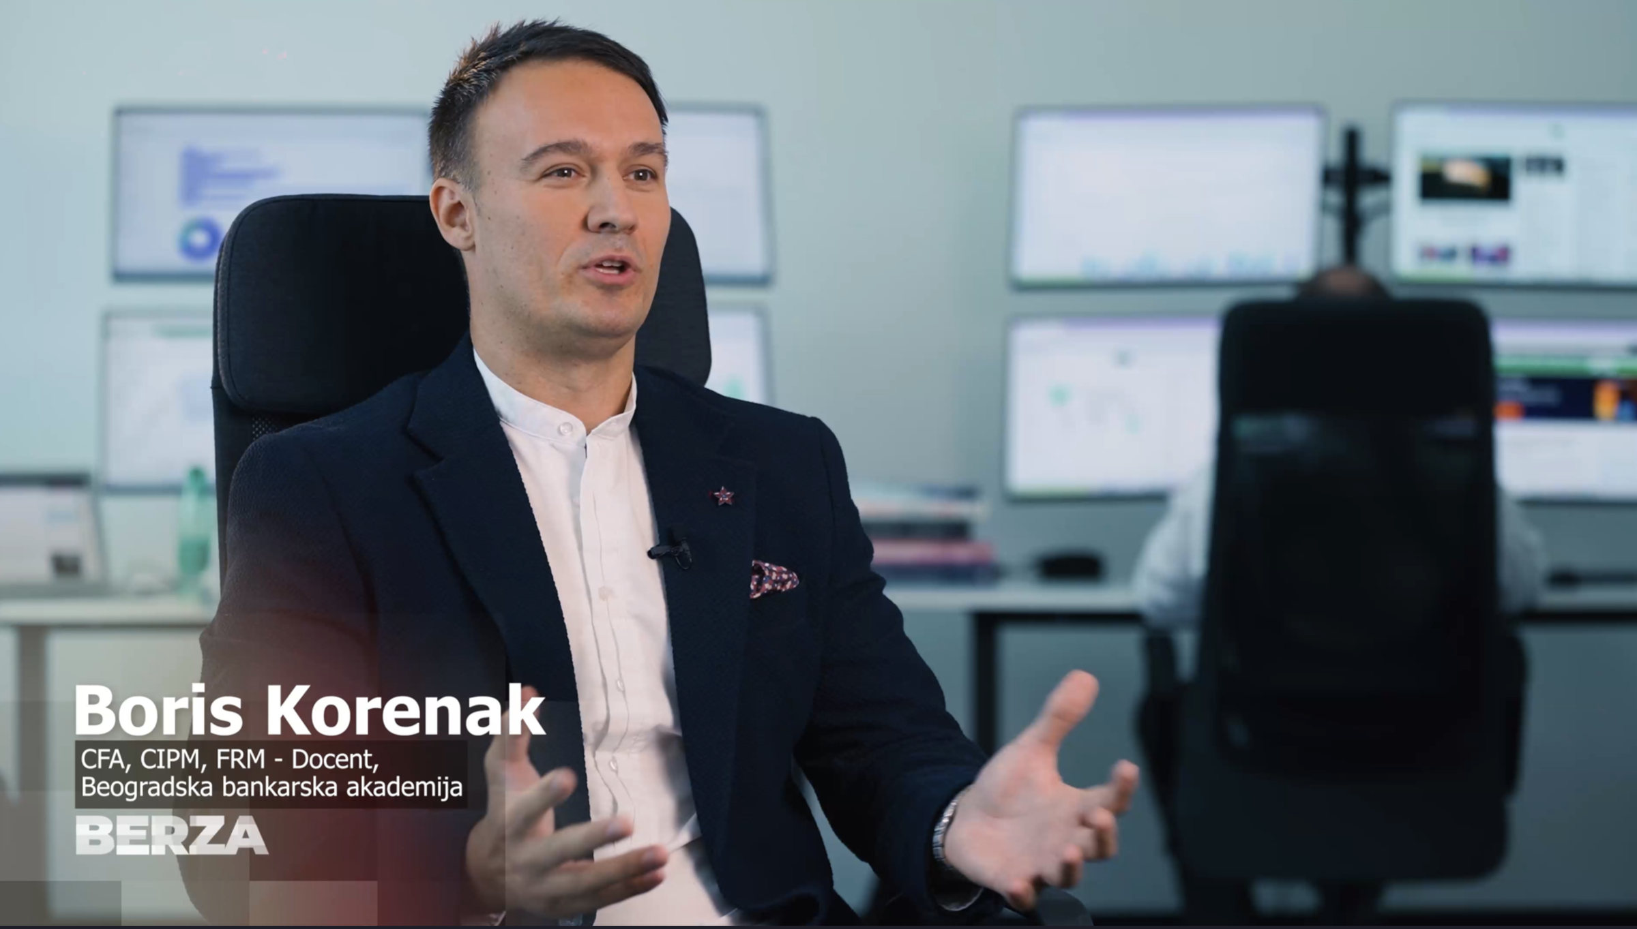
OUR TEAM
Dr Boris Korenak, CFA, CIPM, FRM
Managing Partner at Investometrix Group, Toronto, specializing in Investment Performance, Risk Analytics, and Financial Modeling.
Assistant Professor at the Belgrade Banking Academy.
Consultant at Ministry of Finance of the Republic of Serbia.
Supervisory Board Member and Risk Committee President at Eclectica Capital Asset Management Company.
Active investor in financial markets – mainly ETFs and individual stocks.
Instructor for traders at trading floor in Dubai Multi Commodities Centre, as well as mentor and prep provider for CFA Program in Dubai Knowledge Park.

Slide 10
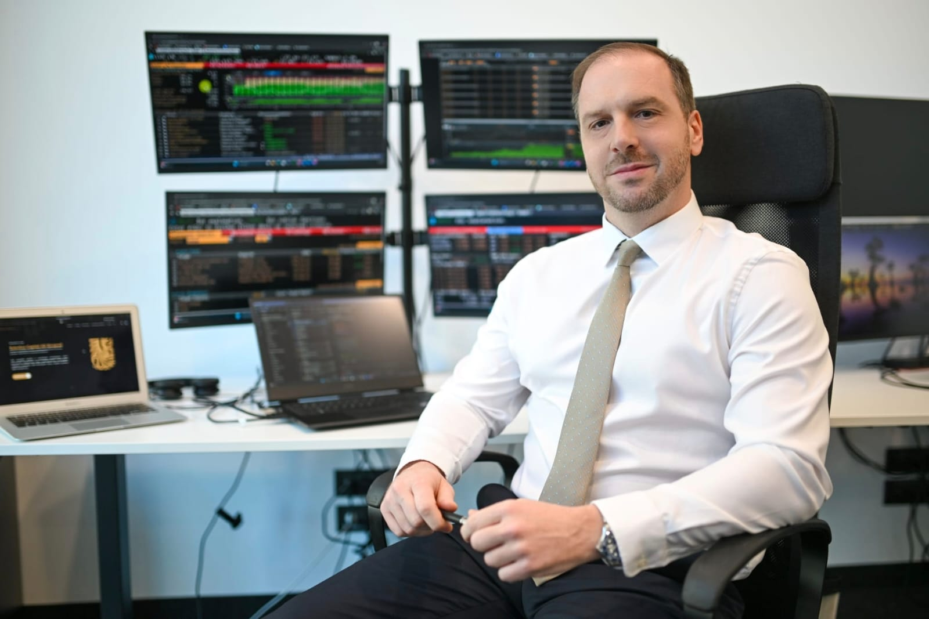
OUR TEAM
Prof. dr Nikola Stakić, CFA
Portfolio manager and Investment Committee President at Eclectica Capital Asset Management Company.
University Professor in finance domain, with nearly 20 years of experience in domestic and international academic sector. Visiting professor in several HEIs in Europe and Middle East.
CFA Charterholder with experience in CFA Program preparatory courses.
Consultant for capital markets development.
Long-standing investor in financial markets and stock exchanges, including options, stocks, and ETFs.

Slide 11
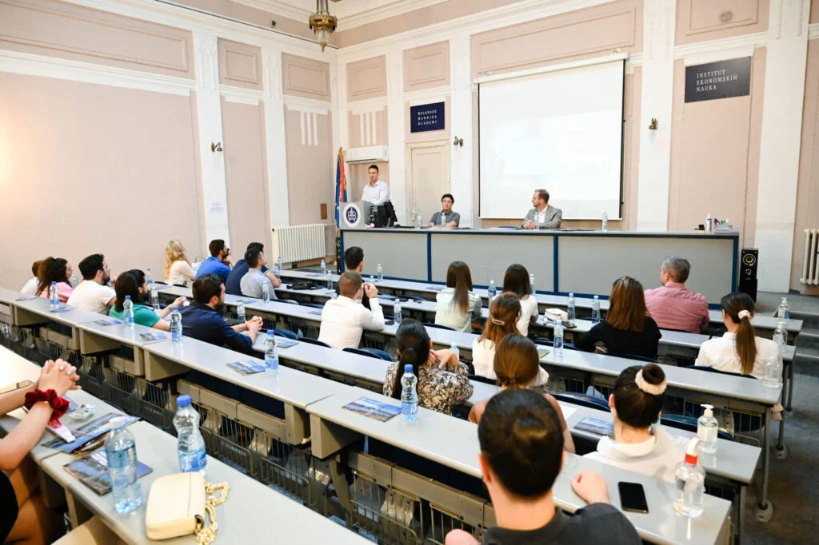
OUR TEAM
Danica Pavlović, CFA, CIPM
Educator at the Belgrade Stock Exchange, responsible for teaching at the BGDx Bloomberg Finance Lab.
Freelance consultant and lecturer on finance-related topics.
Licensed portfolio manager who contributed to the development of Eclectica Capital Asset Management Company.
Taught finance-related courses at the Belgrade Banking Academy, Union University, and the Faculty of Economics and Business, University of Belgrade.

Slide 12
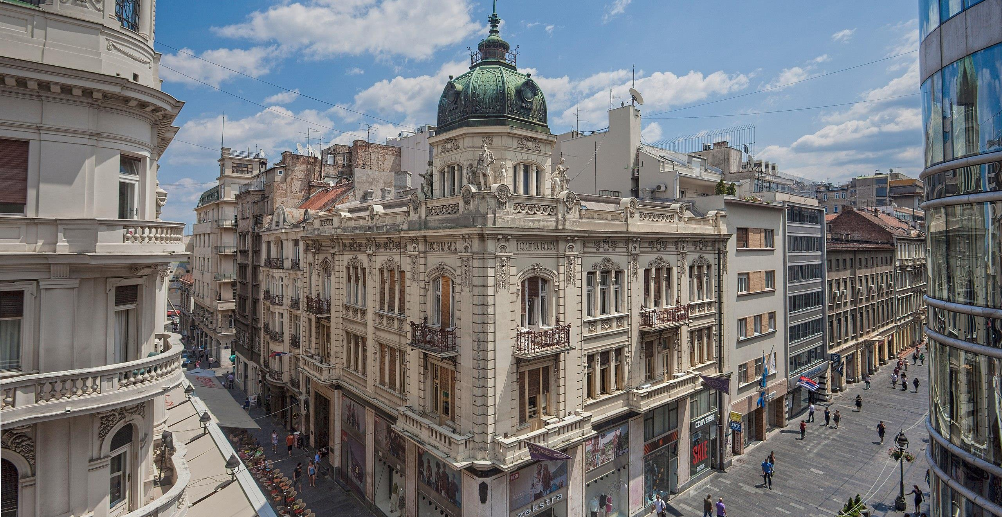
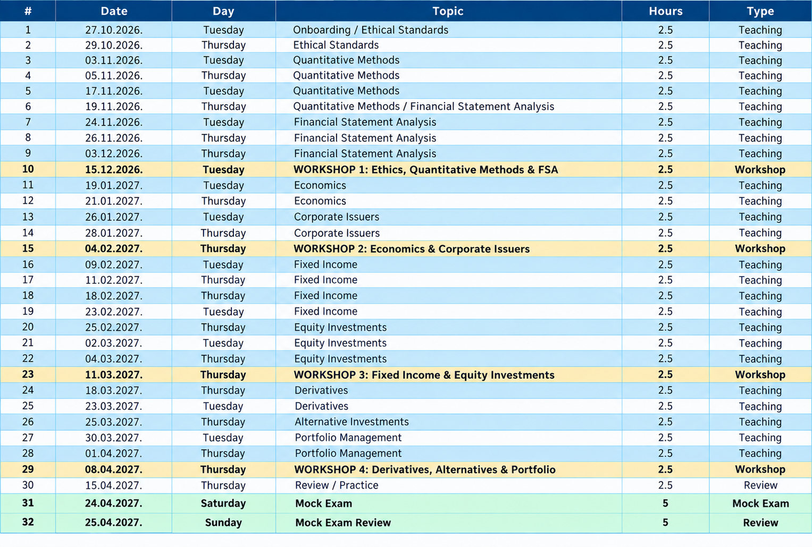
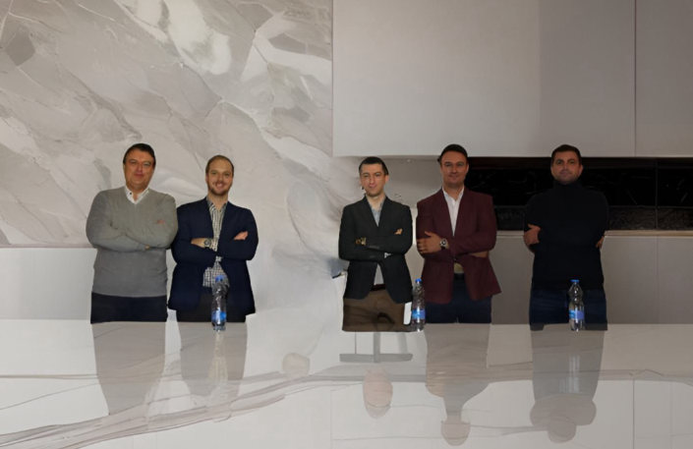
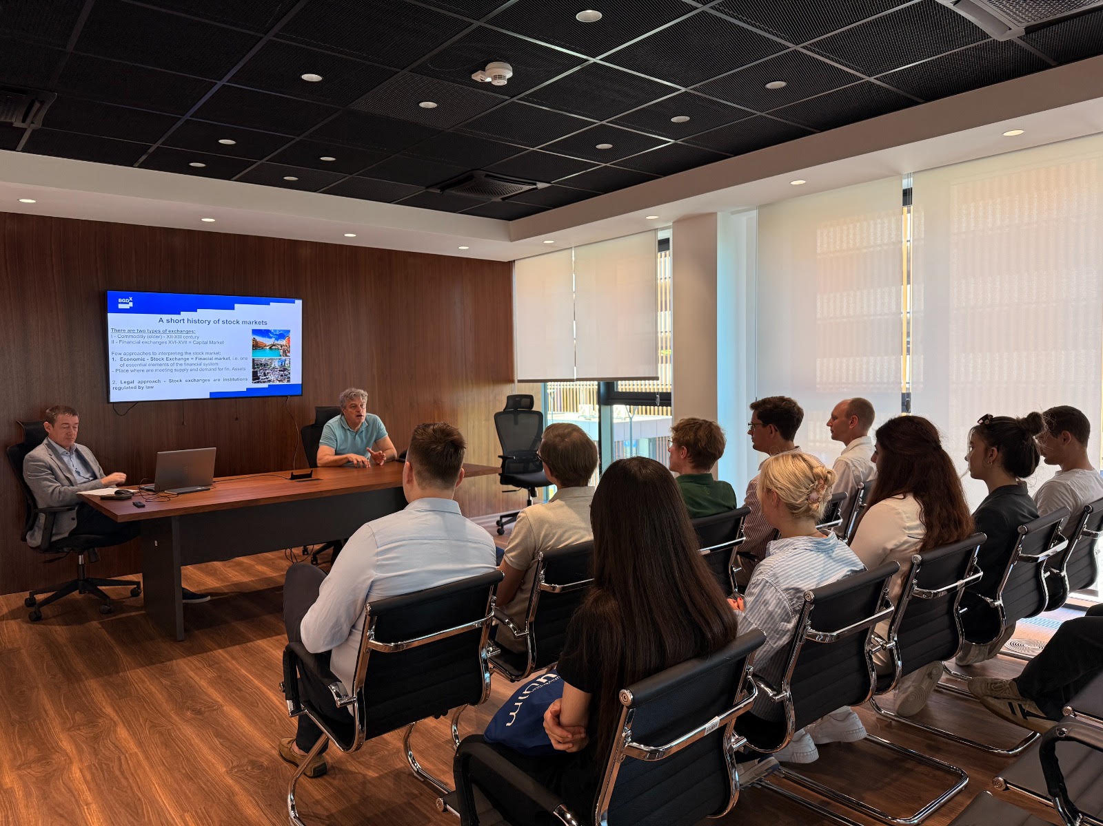
* Tuesdays and Thursdays, 6:00 PM – 8:30 PM

Slide 13

    PREP COURSE TOTAL PRICE: 980 EUR
    TWO installments provided:
    50% - Registration date
    50% - One month after registration
    Info Session: 12.10.2026. at 6 PM
    Course start date: 27.10.2026.
    Course end date: 25.04.2027.
    Tuesdays & Thursdays 6 PM – 8:30 PM,
    Belgrade Stock Exchange,
    Zorana Žunkovića 5, Building A1
    (Live online sessions will be possible)
    Book your place on time!

Slide 14
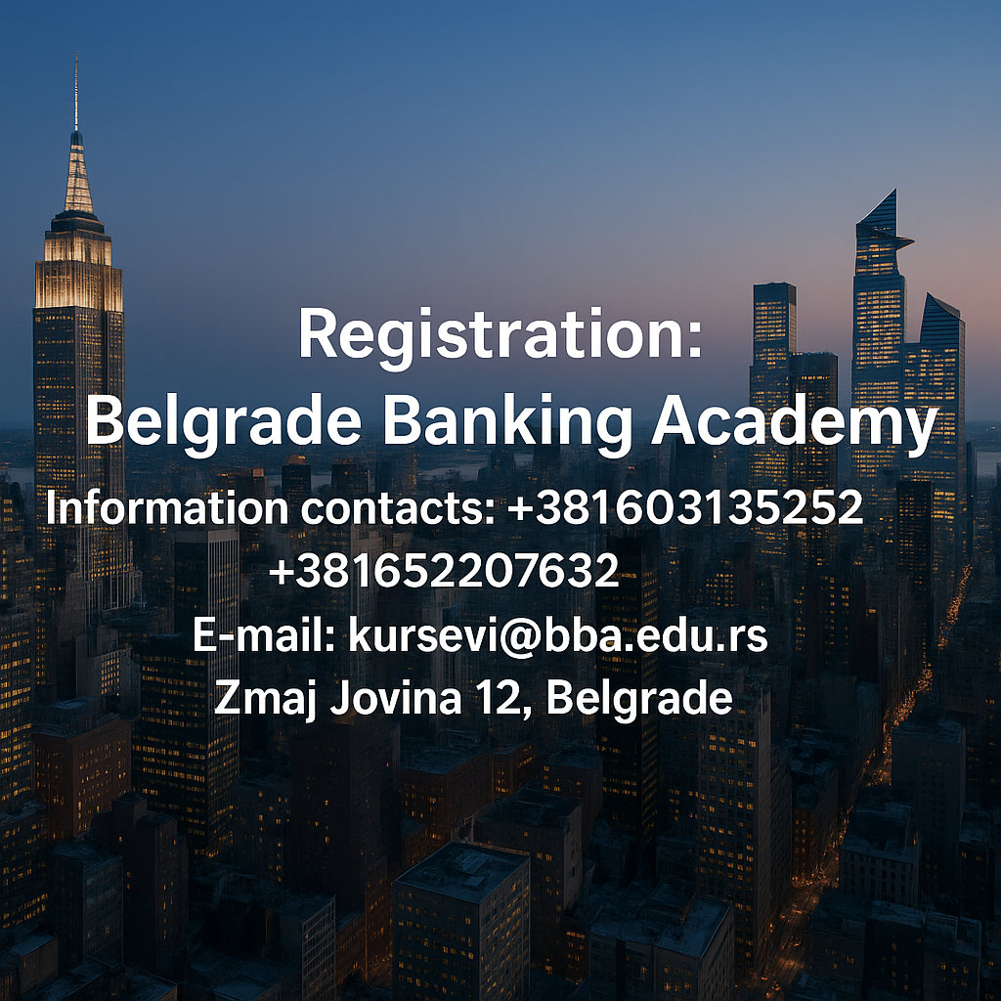
“The size of your success is measured by the strength of your desire; the size of your dream; and how you handle disappointment along the way”
.
Investometrix follows CFA Institute Prep Provider Guidelines. The material is developed to complement the CFA® Program curriculum and to facilitate the learning process. It is not to be used as a substitute for study of the core curriculum. CFA Institute does not endorse, promote, or warrant the accuracy or quality of the products or services offered by Investometrix. CFA®, CIPM® and GIPS® are trademarks owned by CFA Institute.

